Slide 1
Snack Squad: a customizable snack ordering and delivery app
Akilesh J S
Sharvesh K
Koushik Balaji
Roshaun Infant
Tiruvikraman V

Slide 2
DESCRIPTION
Snack Squad: Mobile Snack Ordering Application
UI Framework:
Built with Android Jetpack Compose
Modern, responsive design using Material Design
Dynamic food catalog with interactive cards
Key Features:
Location-based ordering
Special discount promotions
Scrollable popular food menu
Individual food item cards with:
Star ratings
Images
Pricing
Quick add-to-cart functionality

Slide 3
Current Implementation:
Supports multiple food and beverage categories Simple navigation between screens Intuitive user interface Preset food items with images and names Technologies: Kotlin Jetpack Compose Material Design Components Android UI/UX best practices The description now closely reflects the actual code you've shared, highlighting the current state of the Snack Squad application while maintaining the slide-friendly format.

Slide 4
AdminActivity.kt:
package com.example.snackordering
import android.icu.text.SimpleDateFormat
import android.os.Bundle
import android.util.Log
import androidx.activity.ComponentActivity
import androidx.activity.compose.setContent
import androidx.compose.foundation.Image
import androidx.compose.foundation.layout.*
import androidx.compose.foundation.lazy.LazyColumn
import androidx.compose.foundation.lazy.LazyRow
import androidx.compose.foundation.lazy.items
import androidx.compose.material.MaterialTheme
import androidx.compose.material.Surface
import androidx.compose.material.Text
import androidx.compose.runtime.Composable
import androidx.compose.ui.Modifier
import androidx.compose.ui.graphics.Color
import androidx.compose.ui.layout.ContentScale
import androidx.compose.ui.res.painterResource
import androidx.compose.ui.unit.dp
import androidx.compose.ui.unit.sp
import com.example.snackordering.ui.theme.SnackOrderingTheme
import java.util.*

Slide 5
class AdminActivity : ComponentActivity() {
private lateinit var orderDatabaseHelper: OrderDatabaseHelper
override fun onCreate(savedInstanceState: Bundle?) {
super.onCreate(savedInstanceState)
orderDatabaseHelper = OrderDatabaseHelper(this)
setContent {
SnackOrderingTheme {
// A surface container using the 'background' color from the theme
Surface(
modifier = Modifier.fillMaxSize(),
color = MaterialTheme.colors.background
) {
val data=orderDatabaseHelper.getAllOrders();
Log.d("swathi" ,data.toString())
val order = orderDatabaseHelper.getAllOrders()
ListListScopeSample(order)
}
}
}
}
}

Slide 6
@Composable
fun ListListScopeSample(order: List<Order>) {
Image(
painterResource(id = R.drawable.order), contentDescription = "",
alpha =0.5F,
contentScale = ContentScale.FillHeight)
Text(text = "Order Tracking", modifier = Modifier.padding(top = 24.dp, start = 106.dp, bottom = 24.dp ), color = Color.White, fontSize = 30.sp)
Spacer(modifier = Modifier.height(30.dp))
LazyRow(
modifier = Modifier
.fillMaxSize()
.padding(top = 80.dp),
horizontalArrangement = Arrangement.SpaceBetween
){
item {
LazyColumn {
items(order) { order ->
Column(modifier = Modifier.padding(top = 16.dp, start = 48.dp, bottom = 20.dp)) {
Text("Quantity: ${order.quantity}")
Text("Address: ${order.address}")
}
}
}
}

Slide 7
LoginActivity.kt:
package com.example.snackordering
import android.content.Context
import android.content.Intent
import android.os.Bundle
import androidx.activity.ComponentActivity
import androidx.activity.compose.setContent
import androidx.compose.foundation.Image
import androidx.compose.foundation.layout.*
import androidx.compose.material.*
import androidx.compose.runtime.*
import androidx.compose.ui.Alignment
import androidx.compose.ui.Modifier
import androidx.compose.ui.graphics.Color
import androidx.compose.ui.layout.ContentScale
import androidx.compose.ui.res.painterResource
import androidx.compose.ui.text.font.FontFamily
import androidx.compose.ui.text.font.FontWeight
import androidx.compose.ui.unit.dp
import androidx.compose.ui.unit.sp
import androidx.core.content.ContextCompat
import com.example.snackordering.ui.theme.SnackOrderingTheme

Slide 8
class LoginActivity : ComponentActivity() {
private lateinit var databaseHelper: UserDatabaseHelper
override fun onCreate(savedInstanceState: Bundle?) {
super.onCreate(savedInstanceState)
databaseHelper = UserDatabaseHelper(this)
setContent {
SnackOrderingTheme {
// A surface container using the 'background' color from the theme
Surface(
modifier = Modifier.fillMaxSize(),
color = MaterialTheme.colors.background
) {
LoginScreen(this, databaseHelper)
}
}
}
}
}

Slide 9
@Composable
fun LoginScreen(context: Context, databaseHelper: UserDatabaseHelper) {
Image(painterResource(id = R.drawable.order), contentDescription = "",
alpha =0.3F,
contentScale = ContentScale.FillHeight,
)
var username by remember { mutableStateOf("") }
var password by remember { mutableStateOf("") }
var error by remember { mutableStateOf("") }
Column(
modifier = Modifier.fillMaxSize(),
horizontalAlignment = Alignment.CenterHorizontally,
verticalArrangement = Arrangement.Center
) {
Text(
fontSize = 36.sp,
fontWeight = FontWeight.ExtraBold,
fontFamily = FontFamily.Cursive,
color = Color.White,
text = "Login"
)
Spacer(modifier = Modifier.height(10.dp))

Slide 10
TextField(
value = username,
onValueChange = { username = it },
label = { Text("Username") },
modifier = Modifier.padding(10.dp)
.width(280.dp)
)
TextField(
value = password,
onValueChange = { password = it },
label = { Text("Password") },
modifier = Modifier.padding(10.dp)
.width(280.dp)
)
if (error.isNotEmpty()) {
Text(
text = error,
color = MaterialTheme.colors.error,
modifier = Modifier.padding(vertical = 16.dp)
)
}

Slide 11
Button(
onClick = {
if (username.isNotEmpty() && password.isNotEmpty()) {
val user = databaseHelper.getUserByUsername(username)
if (user != null && user.password == password) {
error = "Successfully log in"
context.startActivity(
Intent(
context,
MainPage::class.java
)
)
//onLoginSuccess()
}

Slide 12
if (user != null && user.password == "admin") {
error = "Successfully log in"
context.startActivity(
Intent(
context,
AdminActivity::class.java
)
)
}
else {
error = "Invalid username or password"
}
} else {
error = "Please fill all fields"
}
},
modifier = Modifier.padding(top = 16.dp)
) {
Text(text = "Login")
}
Row {
TextButton(onClick = {context.startActivity(
Intent(
context,
MainActivity::class.java
)
)}
)
{ Text(color = Color.White,text = "Sign up") }

Slide 13
TextButton(onClick = {
})
{
Spacer(modifier = Modifier.width(60.dp))
Text(color = Color.White,text = "Forget password?")
}
}
}
}
private fun startMainPage(context: Context) {
val intent = Intent(context, MainPage::class.java)
ContextCompat.startActivity(context, intent, null)
}

Slide 14
MainPage.kt
package com.example.snackordering
import android.annotation.SuppressLint
import android.content.Context
import android.os.Bundle
import android.widget.Toast
import androidx.activity.ComponentActivity
import androidx.activity.compose.setContent
import androidx.annotation.DrawableRes
import androidx.annotation.StringRes
import androidx.compose.foundation.Image
import androidx.compose.foundation.background
import androidx.compose.foundation.layout.*
import androidx.compose.foundation.shape.CircleShape
import androidx.compose.foundation.shape.RoundedCornerShape
import androidx.compose.material.*
import androidx.compose.material.icons.Icons
import androidx.compose.material.icons.filled.*
import androidx.compose.runtime.Composable
import androidx.compose.ui.Alignment
import androidx.compose.ui.Modifier
import androidx.compose.ui.draw.clip
import androidx.compose.ui.graphics.Color
import androidx.compose.foundation.lazy.LazyColumn
import androidx.compose.foundation.lazy.items
import androidx.compose.material.Text
import androidx.compose.ui.unit.dp

Slide 15
import androidx.compose.ui.graphics.RectangleShape
import androidx.compose.ui.layout.ContentScale
import androidx.compose.ui.platform.LocalContext
import androidx.compose.ui.res.painterResource
import androidx.compose.ui.res.stringResource
import androidx.compose.ui.text.font.FontWeight
import androidx.compose.ui.unit.sp
import androidx.core.content.ContextCompat.startActivity
import com.example.snackordering.ui.theme.SnackOrderingTheme
import android.content.Intent as Intent1
class MainPage : ComponentActivity() {
override fun onCreate(savedInstanceState: Bundle?) {
super.onCreate(savedInstanceState)
setContent {
SnackOrderingTheme {
// A surface container using the 'background' color from the theme
Surface(
modifier = Modifier.fillMaxSize(),
color = MaterialTheme.colors.background
) {
FinalView(this)
val context = LocalContext.current
//PopularFoodColumn(context)
}
}
}
}
}

Slide 16
@Composable
fun TopPart() {
Row(
modifier = Modifier
.fillMaxWidth()
.background(Color(0xffeceef0)), Arrangement.SpaceBetween
) {
Icon(
imageVector = Icons.Default.Add, contentDescription = "Menu Icon",
Modifier
.clip(CircleShape)
.size(40.dp),
tint = Color.Black,
)
Column(horizontalAlignment = Alignment.CenterHorizontally) {
Text(text = "Location", style = MaterialTheme.typography.subtitle1, color = Color.Black)
Row {
Icon(
imageVector = Icons.Default.LocationOn,
contentDescription = "Location",
tint = Color.Red,
)
Text(text = "Accra" , color = Color.Black)
}
}
Icon(
imageVector = Icons.Default.Notifications, contentDescription = "Notification Icon",

Slide 17
Modifier
.size(45.dp),
tint = Color.Black,
)
}
}
@Composable
fun CardPart() {
Card(modifier = Modifier.size(width = 310.dp, height = 150.dp), RoundedCornerShape(20.dp)) {
Row(modifier = Modifier.padding(10.dp), Arrangement.SpaceBetween) {
Column(verticalArrangement = Arrangement.spacedBy(12.dp)) {
Text(text = "Get Special Discounts")
Text(text = "up to 85%", style = MaterialTheme.typography.h5)
Button(onClick = {}, colors = ButtonDefaults.buttonColors(Color.White)) {
Text(text = "Claim voucher", color = MaterialTheme.colors.surface)
}
}
Image(
painter = painterResource(id = R.drawable.food_tip_im),
contentDescription = "Food Image", Modifier.size(width = 100.dp, height = 200.dp)
)
}
}
}

Slide 18
@Composable
fun PopularFood(
@DrawableRes drawable: Int,
@StringRes text1: Int,
context: Context
) {
Card(
modifier = Modifier
.padding(top=20.dp, bottom = 20.dp, start = 65.dp)
.width(250.dp)
) {
Column(
verticalArrangement = Arrangement.Top,
horizontalAlignment = Alignment.CenterHorizontally
) {
Spacer(modifier = Modifier.padding(vertical = 5.dp))
Row(
modifier = Modifier
.fillMaxWidth(0.7f), Arrangement.End
) {
Icon(
imageVector = Icons.Default.Star,
contentDescription = "Star Icon",
tint = Color.Yellow
)
Text(text = "4.3", fontWeight = FontWeight.Black)
}

Slide 19
Image(
painter = painterResource(id = drawable),
contentDescription = "Food Image",
contentScale = ContentScale.Crop,
modifier = Modifier
.size(100.dp)
.clip(CircleShape)
)
Text(text = stringResource(id = text1), fontWeight = FontWeight.Bold)
Row(modifier = Modifier.fillMaxWidth(0.7f), Arrangement.SpaceBetween) {
/*TODO Implement Prices for each card*/
Text(
text = "$50",
style = MaterialTheme.typography.h6,
fontWeight = FontWeight.Bold,
fontSize = 18.sp
)
IconButton(onClick = {
//var no=FoodList.lastIndex;
//Toast.
val intent = Intent1(context, TargetActivity::class.java)
context.startActivity(intent)

Slide 20
}) {
Icon(
imageVector = Icons.Default.ShoppingCart,
contentDescription = "shopping cart",
)
}
}
}
}
}
private val FoodList = listOf(
R.drawable.sandwish to R.string.sandwich,
R.drawable.sandwish to R.string.burgers,
R.drawable.pack to R.string.pack,
R.drawable.pasta to R.string.pasta,
R.drawable.tequila to R.string.tequila,
R.drawable.wine to R.string.wine,
R.drawable.salad to R.string.salad,
R.drawable.pop to R.string.popcorn
).map { DrawableStringPair(it.first, it.second) }
private data class DrawableStringPair(
@DrawableRes val drawable: Int,
@StringRes val text1: Int
)

Slide 21
@Composable
fun App(context: Context) {
Column(
modifier = Modifier
.fillMaxSize()
.background(Color(0xffeceef0))
.padding(10.dp),
verticalArrangement = Arrangement.Top,
horizontalAlignment = Alignment.CenterHorizontally
) {
Surface(modifier = Modifier, elevation = 5.dp) {
TopPart()
}
Spacer(modifier = Modifier.padding(10.dp))
CardPart()
Spacer(modifier = Modifier.padding(10.dp))
Row(modifier = Modifier.fillMaxWidth(), Arrangement.SpaceBetween) {
Text(text = "Popular Food", style = MaterialTheme.typography.h5, color = Color.Black)
Text(text = "view all", style = MaterialTheme.typography.subtitle1, color = Color.Black)
}
Spacer(modifier = Modifier.padding(10.dp))
PopularFoodColumn(context) // <- call the function with parentheses
}
}

Slide 22
@Composable
fun PopularFoodColumn(context: Context) {
LazyColumn(
modifier = Modifier.fillMaxSize(),
content = {
items(FoodList) { item ->
PopularFood(context = context,drawable = item.drawable, text1 = item.text1)
abstract class Context
}
},
verticalArrangement = Arrangement.spacedBy(16.dp))
}
@SuppressLint("UnusedMaterialScaffoldPaddingParameter")
@Composable
fun FinalView(mainPage: MainPage) {
SnackOrderingTheme {
Scaffold() {
val context = LocalContext.current
App(context)
}
}
}

Slide 23
Order.kt:
package com.example.snackordering
import androidx.room.ColumnInfo
import androidx.room.Entity
import androidx.room.PrimaryKey
@Entity(tableName = "order_table")
data class Order(
@PrimaryKey(autoGenerate = true) val id: Int?,
@ColumnInfo(name = "quantity") val quantity: String?,
@ColumnInfo(name = "address") val address: String?,
)

Slide 24
OrderDao.kt:
package com.example.snackordering
import androidx.room.*
@Dao
interface OrderDao {
@Query("SELECT * FROM order_table WHERE address= :address")
suspend fun getOrderByAddress(address: String): Order?
@Insert(onConflict = OnConflictStrategy.REPLACE)
suspend fun insertOrder(order: Order)
@Update
suspend fun updateOrder(order: Order)
@Delete
suspend fun deleteOrder(order: Order)
}

Slide 25
OrderDatabase.kt:
package com.example.snackordering
import android.content.Context
import androidx.room.Database
import androidx.room.Room
import androidx.room.RoomDatabase
@Database(entities = [Order::class], version = 1)
abstract class OrderDatabase : RoomDatabase() {
abstract fun orderDao(): OrderDao
companion object {

Slide 26
@Volatile
private var instance: OrderDatabase? = null
fun getDatabase(context: Context): OrderDatabase {
return instance ?: synchronized(this) {
val newInstance = Room.databaseBuilder(
context.applicationContext,
OrderDatabase::class.java,
"order_database"
).build()
instance = newInstance
newInstance
}
}
}
}

Slide 27
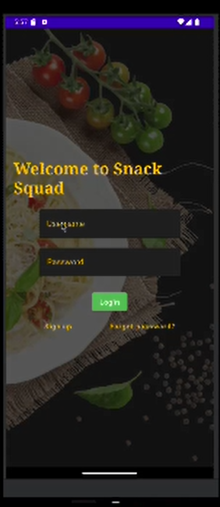
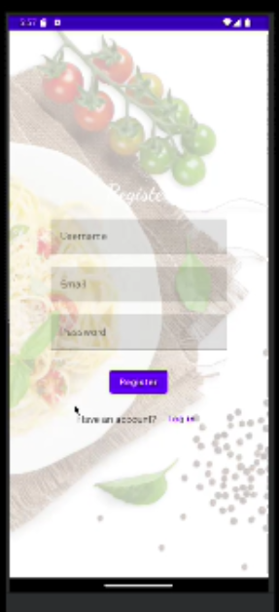
Register Page
Login Page

Slide 28
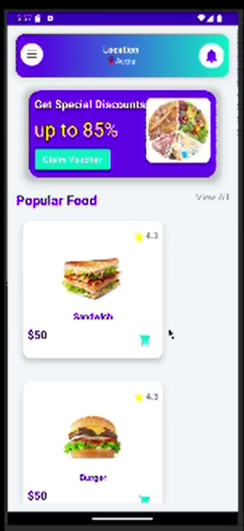
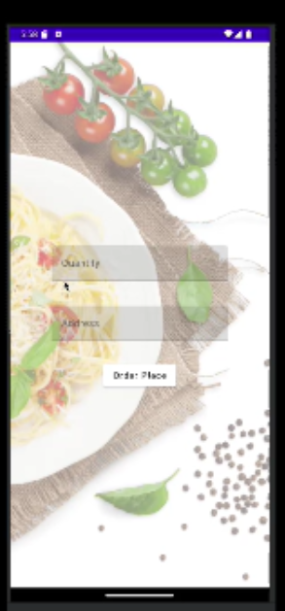
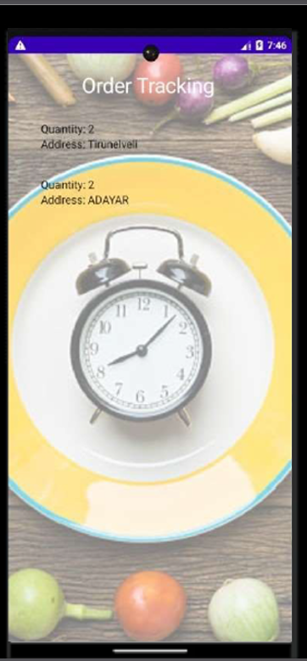
Main Page
Order page
Admin Page

